Slide 1
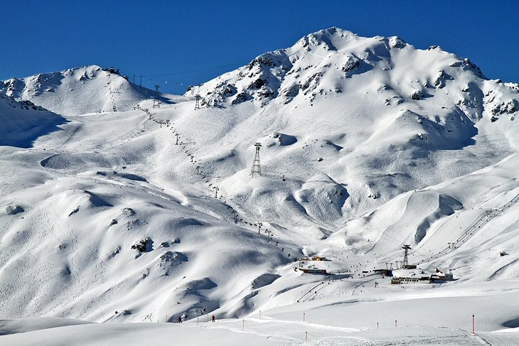



Ski plan made easy and sustainable
Notes:
Can we add mountain and ski vector to the logo….. With colors…

Slide 2
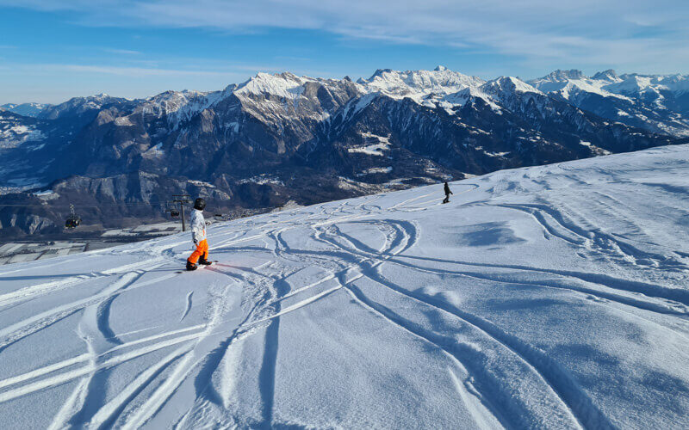








Skiing should be easy and enjoyable, but but but !!!
Ski, finally!
Rentals?
Where to eat though?
Queue for Tickets
Drive
Aah crap, this weather!
Weather info…
Too long queue
Messy digital journey
“Aah, Where should we go…”
“I do not want to spend 30-45 mins buying tickets or rental”
“Why do I have to go to all different resorts websites to get this info”
Notes:
Problems..... What if….!!!!
In Switzerland:

Slide 3

Notes:
What if we bring you all the convenience you need for a ski plan, in 1 place…. We give you – SkiApp…. 1. An app, which gives you all ski resorts data, at a fingertip to you….
2. You got live weather updates to easily plan your ski trip
3. Oner click buy ski pass option…. So you do not have to waste your half hour in the queue…
4. Interactive map of all the ski slopes
5. Rental equipment ordering to avoid lead times at the shop
6. And if that’s not enough, it also tells you all the aperi shi’s happening around Wait, there’s more – We even provide with you the recommendations on the most eco-friendly ski resorts, so you can also make conscious choices….
Who would not want a ski trip like that.!!!!

Slide 4








A clean 1.5million CHF opportunity, dying to be realized
100m CHF
DE/AT/CH/FR market
Expand
1.5m CHF
Swiss market alone
Onboard resorts
Drive adoption
1% commission on ski passes and rental
Notes:
Monetization business model….
It is a 1.5 million serviceable opportunity only in Switzerland…. Which can be upto 100million if expanded geographically, and even more if expanded to seasons.
GTM strategy…. Timeline???

Slide 5
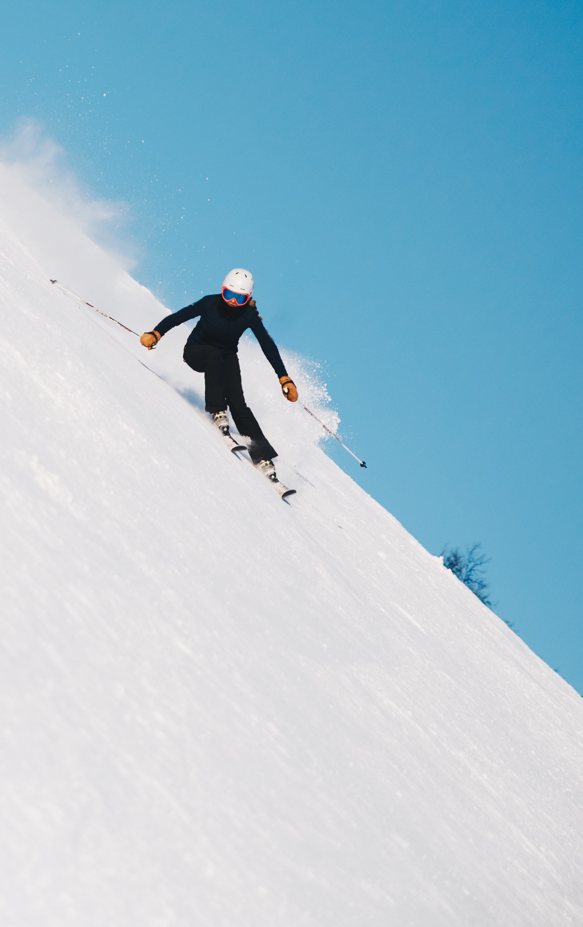







Why is this still not addressed!!!
5
Notes:
What tech we used….!!!
Challenges we faced…. And next steps…
But hey, not all solutions need to be complicated, some need to solve real issues as well. As Einstein said: Simple solutions are often the right ones.

Slide 6
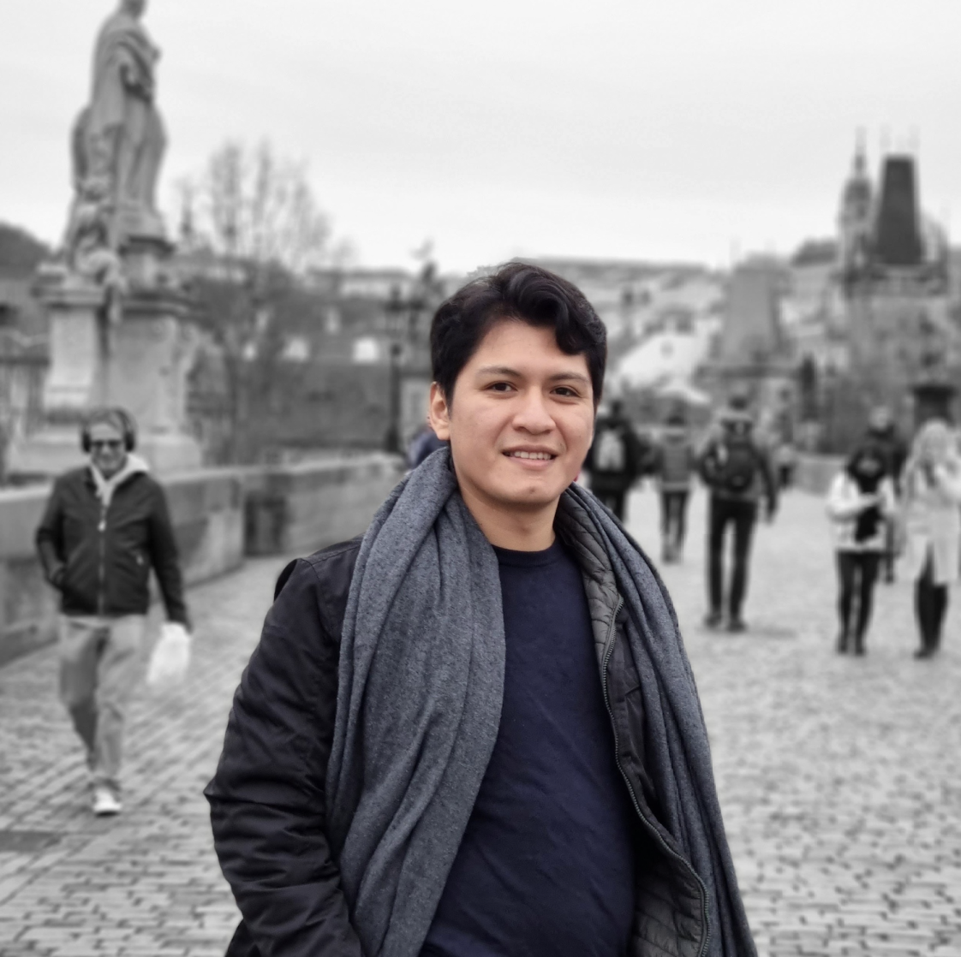

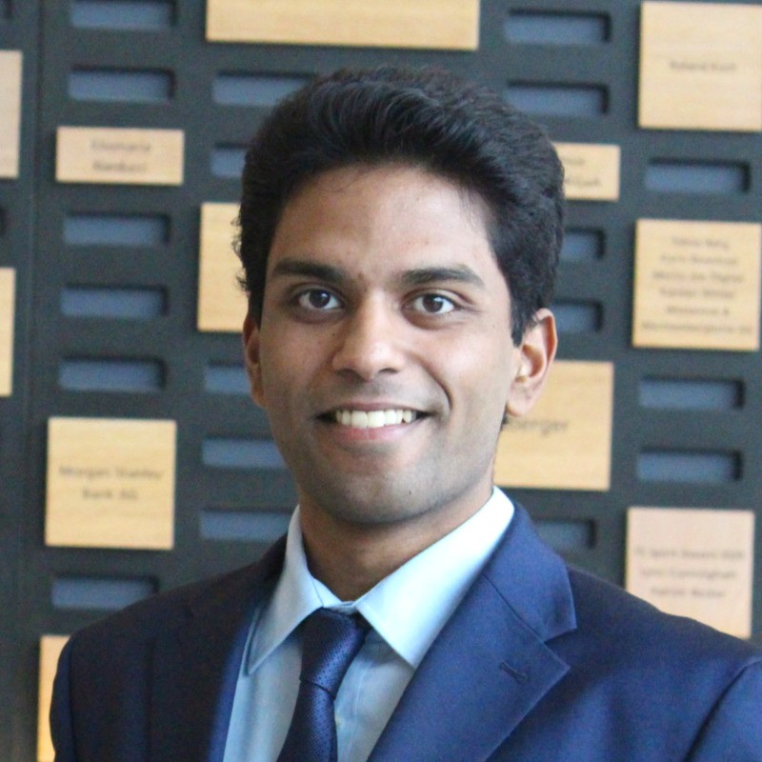



SkiApp
Ski plan made easy and sustainable
Dream Team
Notes:
Change a to Caret symbol….
Our Team….
We are just not any hackers, we are avid skiers…. X years experience in skiing….
Side hustle: Business strategy Qualifications: MBA, HSG etc….
Appeal….
Join us, if you’d want to make your ski travel , EASY and Sustainable.

Slide 7




SkiApp
Ski plan made easy and sustainable
Diego NUÑEZ
1.5 years ski experience
Side hustle: Full stack engineer
Computer Science
Notes:
Change a to Caret symbol….
Our Team….
We are just not any hackers, we are avid skiers…. X years experience in skiing….
Side hustle: Business strategy Qualifications: MBA, HSG etc….
Appeal….
Join us, if you’d want to make your ski travel , EASY and Sustainable.

Slide 8


SkiApp
Ski plan made easy and sustainable
Navanshu AHUJA
6 years ski experience
Side hustle: Business Strategy
MBA + Engineering
Notes:
Change a to Caret symbol….
Our Team….
We are just not any hackers, we are avid skiers…. X years experience in skiing….
Side hustle: Business strategy Qualifications: MBA, HSG etc….
Appeal….
Join us, if you’d want to make your ski travel , EASY and Sustainable.

Slide 9




SkiApp
Ski plan made easy and sustainable
Suriyaa Rocky SUNDARARUBAN
1 year ski experience
Side hustle: Entrepreneurship
Management & Technology
Notes:
Change a to Caret symbol….
Our Team….
We are just not any hackers, we are avid skiers…. X years experience in skiing….
Side hustle: Business strategy Qualifications: MBA, HSG etc….
Appeal….
Join us, if you’d want to make your ski travel , EASY and Sustainable.

Slide 11
Skiing should be easy and enjoyable, but but but !!!
Ski, finally!
Rentals?
Where to eat though?
Queue for Tickets
Drive
Aah crap, this weather!
Too long queue
Messy digital journey
Weather info…
“I do not want to spend 30-45 mins buying tickets or rental”
“Why do I have to go to all different resorts websites to get this info”
“Aah, here comes the storm…”
Notes:
Problems..... What if….!!!!
In Switzerland:

Slide 12
Skiing should be easy and enjoyable, but but but !!!
Ski, finally!
Rentals?
Where to eat though?
Queue for Tickets
Drive
Aah crap, this weather!
Too long queue
Messy digital journey
Weather info…
“I do not want to spend 30-45 mins buying tickets or rental”
“Why do I have to go to all different resorts websites to get this info”
“Aah, here comes the storm…”
Notes:
Problems..... What if….!!!!
In Switzerland:

Slide 13
Skiing should be easy and enjoyable, but but but !!!
Ski, finally!
Rentals?
Where to eat though?
Queue for Tickets
Drive
Aah crap, this weather!
Too long queue
“I do not want to spend 30-45 mins buying tickets or rental”
Messy digital journey
“Why do I have to go to all different resorts websites to get this info”
Weather info…
“Aah, here comes the storm…”
Notes:
Problems..... What if….!!!!
In Switzerland:

Slide 14
SkiApp
Ski plan made easy and sustainable
Diego NUÑEZ
1.5 years ski experience
Side hustle: Full stack engineer
Computer Science
Notes:
Change a to Caret symbol….
Our Team….
We are just not any hackers, we are avid skiers…. X years experience in skiing….
Side hustle: Business strategy Qualifications: MBA, HSG etc….
Appeal….
Join us, if you’d want to make your ski travel , EASY and Sustainable.

Slide 15
SkiApp
Ski plan made easy and sustainable
Diego NUÑEZ
1.5 years ski experience
Side hustle: Full stack engineer
Computer Science
Notes:
Change a to Caret symbol….
Our Team….
We are just not any hackers, we are avid skiers…. X years experience in skiing….
Side hustle: Business strategy Qualifications: MBA, HSG etc….
Appeal….
Join us, if you’d want to make your ski travel , EASY and Sustainable.

Slide 16
SkiApp
Ski plan made easy and sustainable
Suriyaa Rocky SUNDARARUBAN
1 year ski experience
Side hustle: Entrepreneurship
Management & Technology
Notes:
Change a to Caret symbol….
Our Team….
We are just not any hackers, we are avid skiers…. X years experience in skiing….
Side hustle: Business strategy Qualifications: MBA, HSG etc….
Appeal….
Join us, if you’d want to make your ski travel , EASY and Sustainable.

